Slide 1
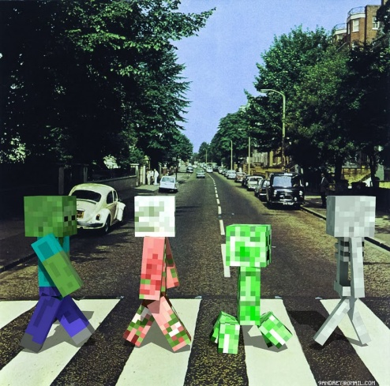

MINECRAFT

Slide 2
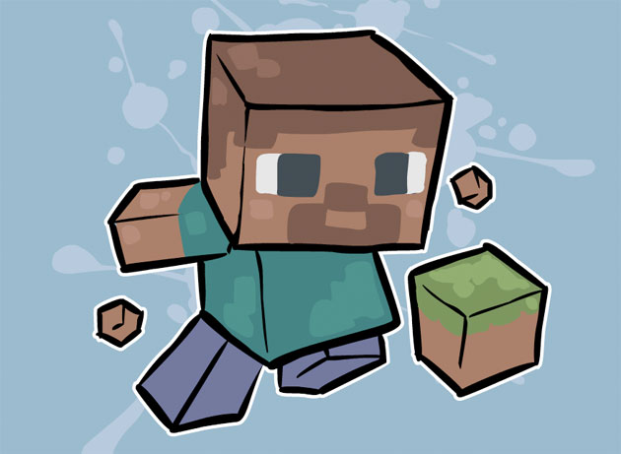
Strategic Gameplay
Players must strategize how to play the game.
They must avoid being attacked by monsters while at the same time build a shelter and find food
Minecraft makes you think, while also being good entertainment.

Slide 3
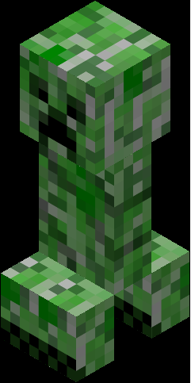
Not everything is Strategy!
Creative mode is simply building, you can fly and there are unlimited items, this is not stressful, and twice as easy.
The peaceful setting completely turns monsters off and you don’t even have to eat! It’s loads easier and my favorite, personally.

Slide 4
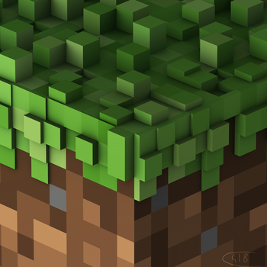
Other Things
There is a free version of Minecraft called classic, in which many of the full version’s options and settings are removed.
A multiplayer version of Minecraft is available, so you can even play with your friends!
A soundtrack has been released featuring many Minecraft songs.

Slide 5
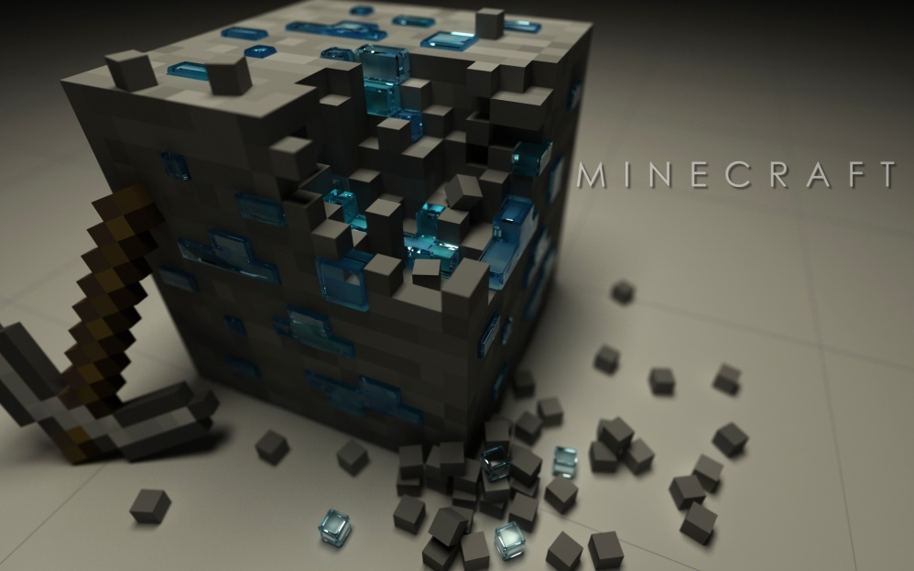
There is a second dimension of Minecraft called the nether, which frankly, resembles a stereotypical hell.
There are dozens of mods which can be added, which just broaden your game play even more.

Slide 6
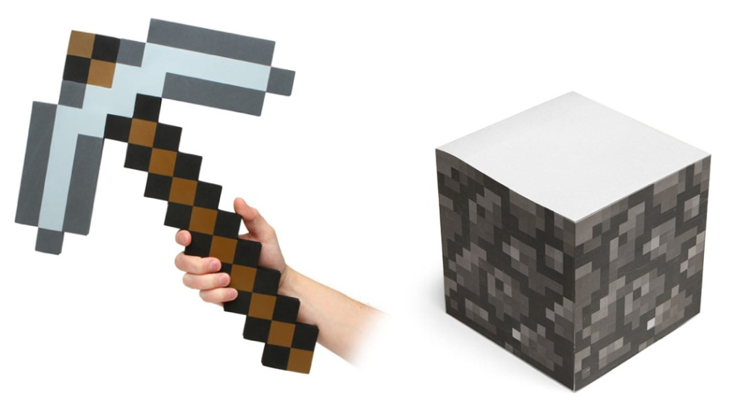
Word Origin
While this is somewhat debatable, Minecraft is mainly about mining and crafting things. You find minerals from mining, along with cobblestone, and then you craft various things from above and below the earth.

Slide 7
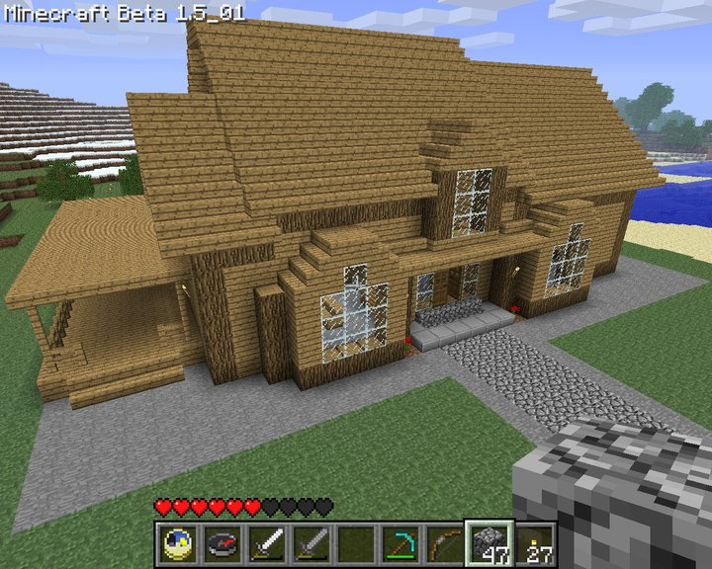
Discover the possibilities!
Once downloaded, Minecraft generates more world until your computer runs out of space (so pretty much forever…)
You can build as big a structure as you want, you’re options are pretty much limitless!

Slide 8


Creator
Markus Alexje Persson (A.K.A Notch) helped create Minecraft
He is a video game developer, and besides helping in the creation of Minecraft, he has also helped design Breaking the Tower and Megatun

Slide 9
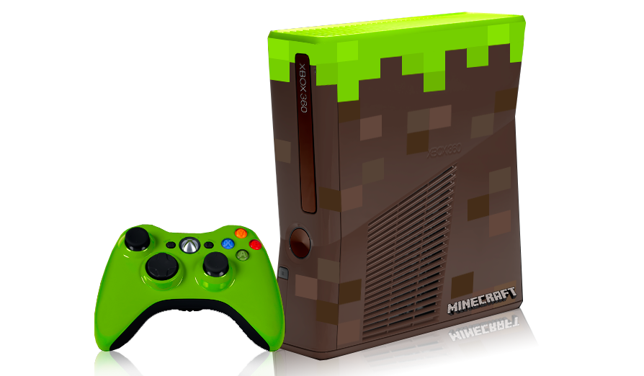
Versions
There have been multiple versions of Minecraft beta to come out in the past, although just recently the full version of Minecraft 1.1 came out for PC on November 18, 2011.
The full version of was released on Android October 7, and on iOS on November 17
It will release for Xbox sometime this year

Slide 10
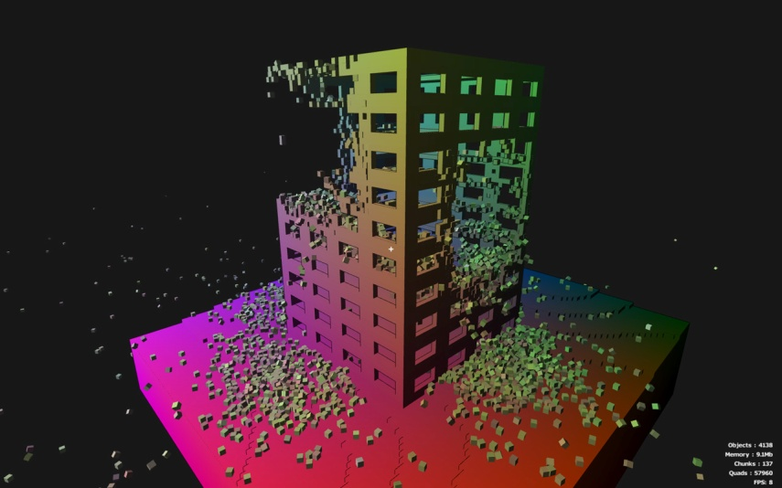
General facts and need-to-know-info.
All structures in Minecraft are made up of 3-D blocks-except for water and lava
It does cost twenty dollars to play, but it is alpha version, and if you want a free version Classic is still out there

Slide 11
Inside the MC World

Slide 12
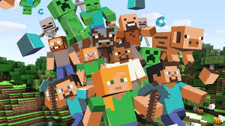
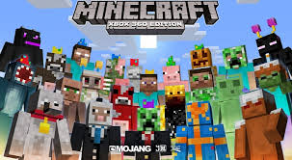
Minecraft skins and mobs
There are 18 skin packs
Also there is 23 mobs in Minecraft

Slide 13
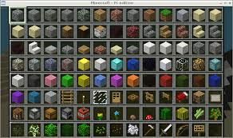
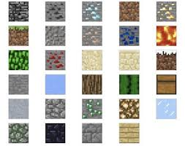
Minecraft blocks
Minecraft’s got some cool blocks!
Here are some names!
Grass
Diamond block
Glowstone
Obsidian
Chest

Slide 14
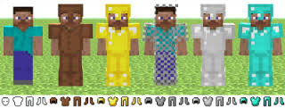
Minecraft armor

Slide 15
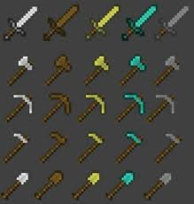
Minecraft tools

Slide 16
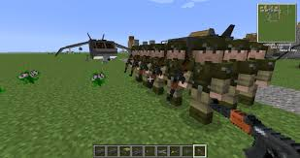
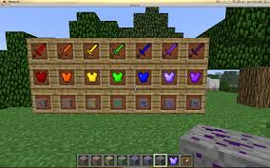
Minecraft mods
You get mods on Pc\Mac only!

Slide 17
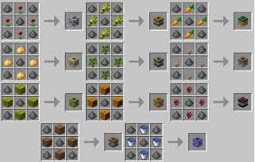
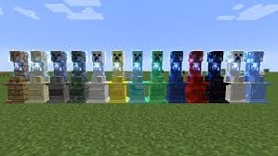
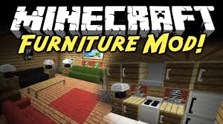
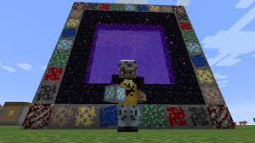
Minecraft mods Part 2

Slide 18
Redstone
Redstone is Minecraft’s source of electricity.
It has many items for it!

Slide 19
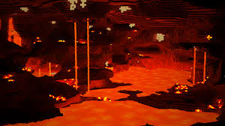
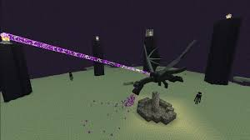
Minecraft dimensions
There are two dimensions!
You can’t sleep in them!
Nether
End

